Slide 1
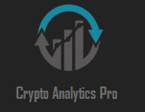
CryptoAnalyticsPro
Muhammad Ali Saleem (23L-2638)
Ammar Hassan (23L-2614)
Hamza Mumtaz (23i-2635)

Slide 2
CONTENTS
Project Introduction
Advantages & Constraints
Non-Functional Requirements
Design Diagrams & Architecture
Implementation
Work Division
Lesson Learnt

Slide 3
Project INTRODUCTION
CryptoAnalyticsPro is a Windows desktop app built with C# WinForms and MS Access to help traders manage crypto portfolios.
It integrates real-time market data for live price tracking and supports multi-currency valuation.
The app offers tools for profit/loss analysis, stop-loss and take-profit calculations, and risk assessment.
AI-powered trade recommendations and sentiment analysis assist users in making data-driven decisions.
Designed to be lightweight and offline-capable, it ensures secure local data storage without cloud complexity.

Slide 4
Advantages
AI-powered trade recommendations improve decision-making based on real data
Real-time sentiment analysis gives users market mood insights
Stop-loss and take-profit tools help manage risk automatically
Multi-currency support enables tracking in various fiat and crypto currencies
Simple, user-friendly desktop UI with offline capability
Uses local database (MS Access), ensuring fast, lightweight data storage
Custom alerts and portfolio visualizations increase usability for all user levels

Slide 5
Constraints
Limited scalability due to MS Access backend
AI recommendation engine is rule-based, not machine learning-powered
No mobile app or cross-platform support
Sentiment analysis is dependent on third-party APIs (availability issues)
Real-time price updates limited by API rate limits
Offline functionality restricts access to updated market data without internet

Slide 6
Non-Functional Requirements
Performance Requirements
Usability Requirements

Slide 7
Performance Requirements
The application must load the dashboard within 3 seconds after startup.
Trade history retrieval should take less than 2 seconds for up to 1,000 records.
The system should support at least 10,000 trade records without performance degradation.

Slide 8
Usability Requirements
The interface should be intuitive and easy to navigate, even for non-technical traders.
Portfolio summaries and trade analytics should be visually appealing using charts and graphs.
The system should provide error messages when incorrect inputs are entered.

Slide 9
Design Diagrams

Slide 10
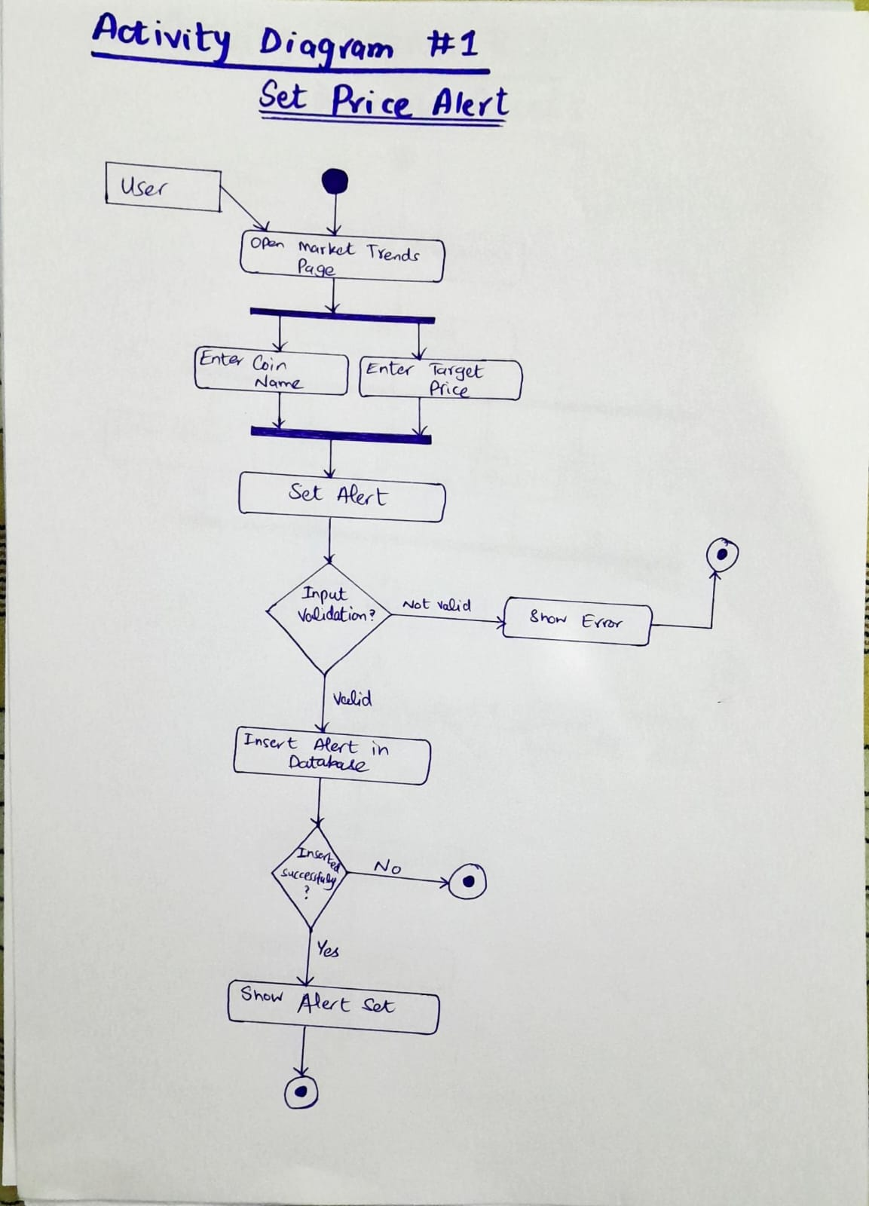
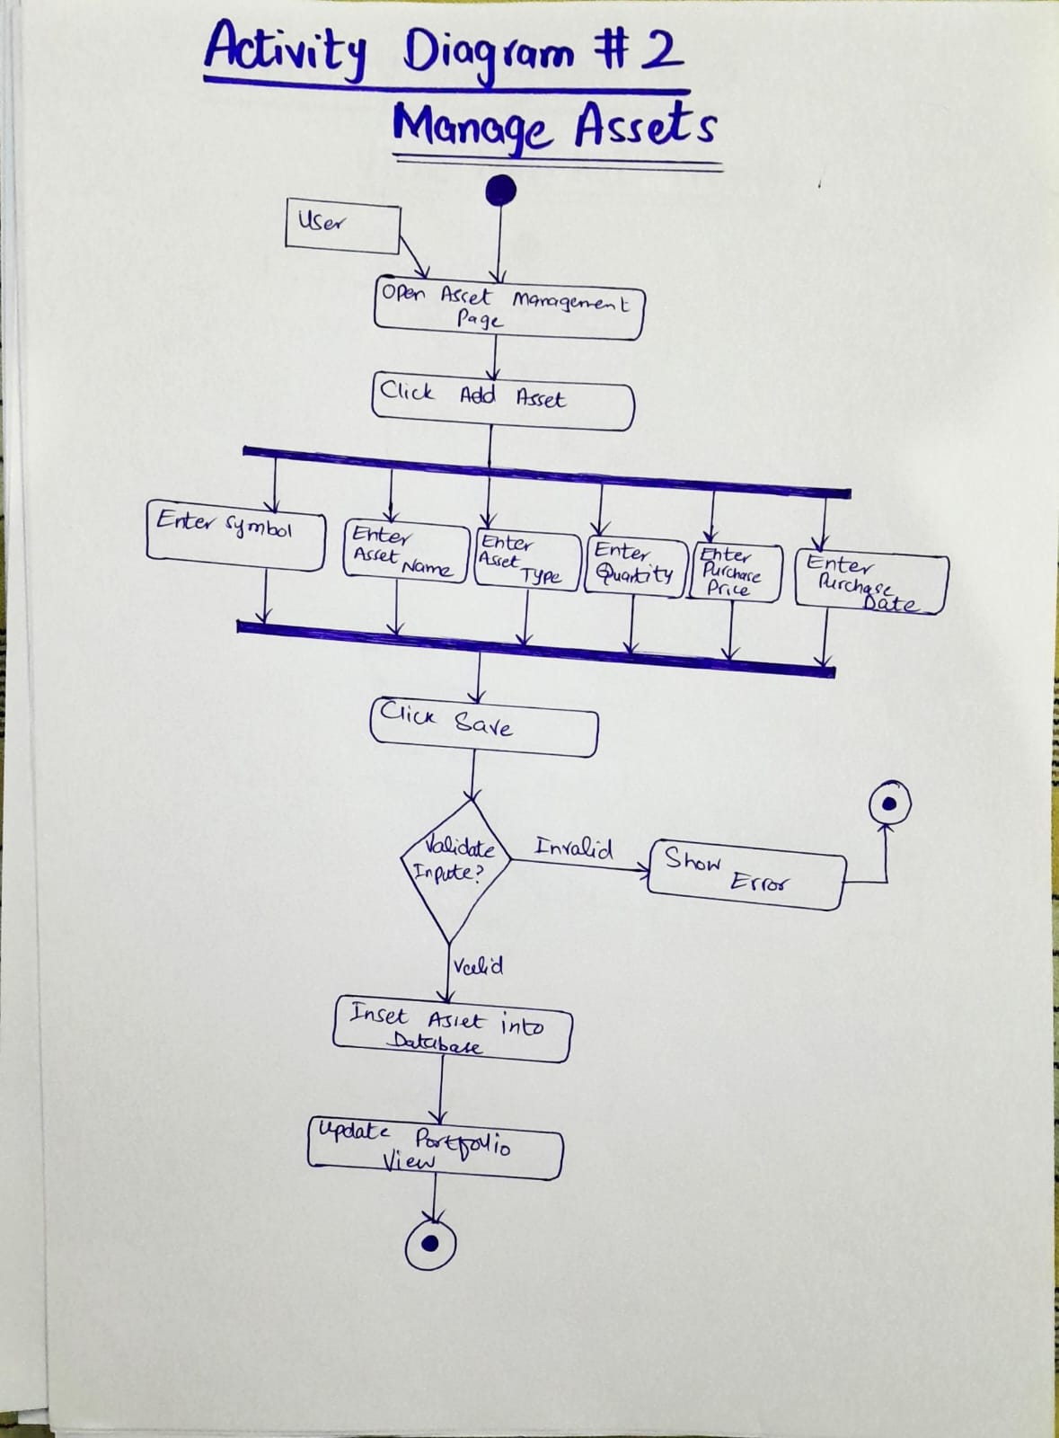
Activity Diagrams

Slide 11
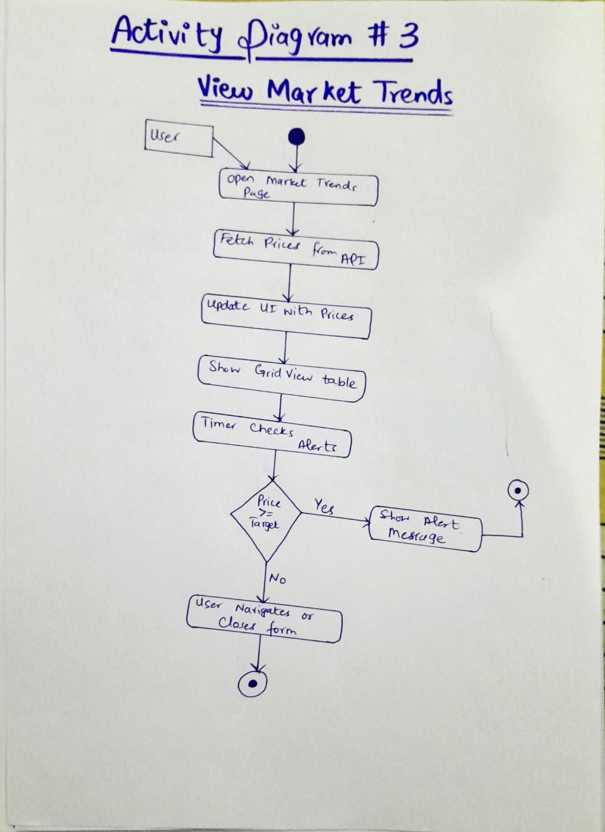
Activity Diagrams

Slide 12
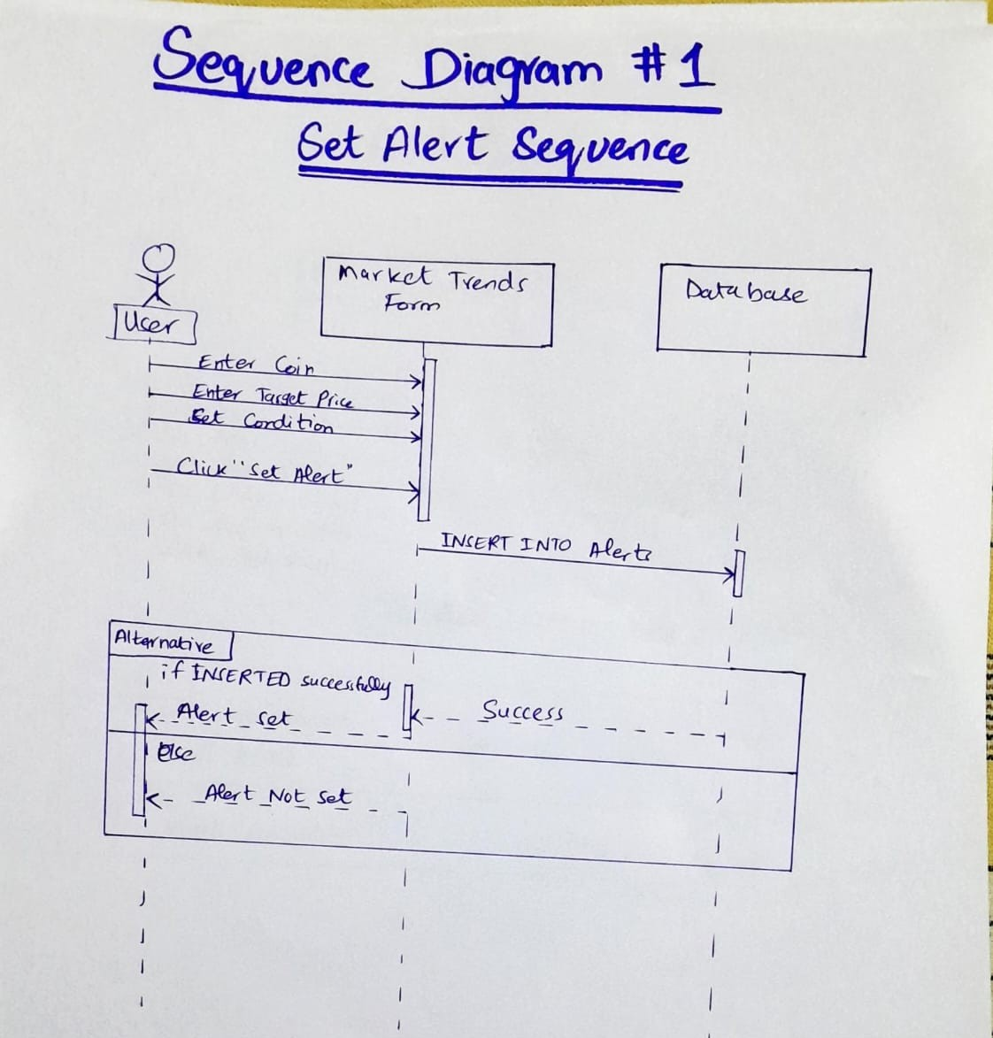
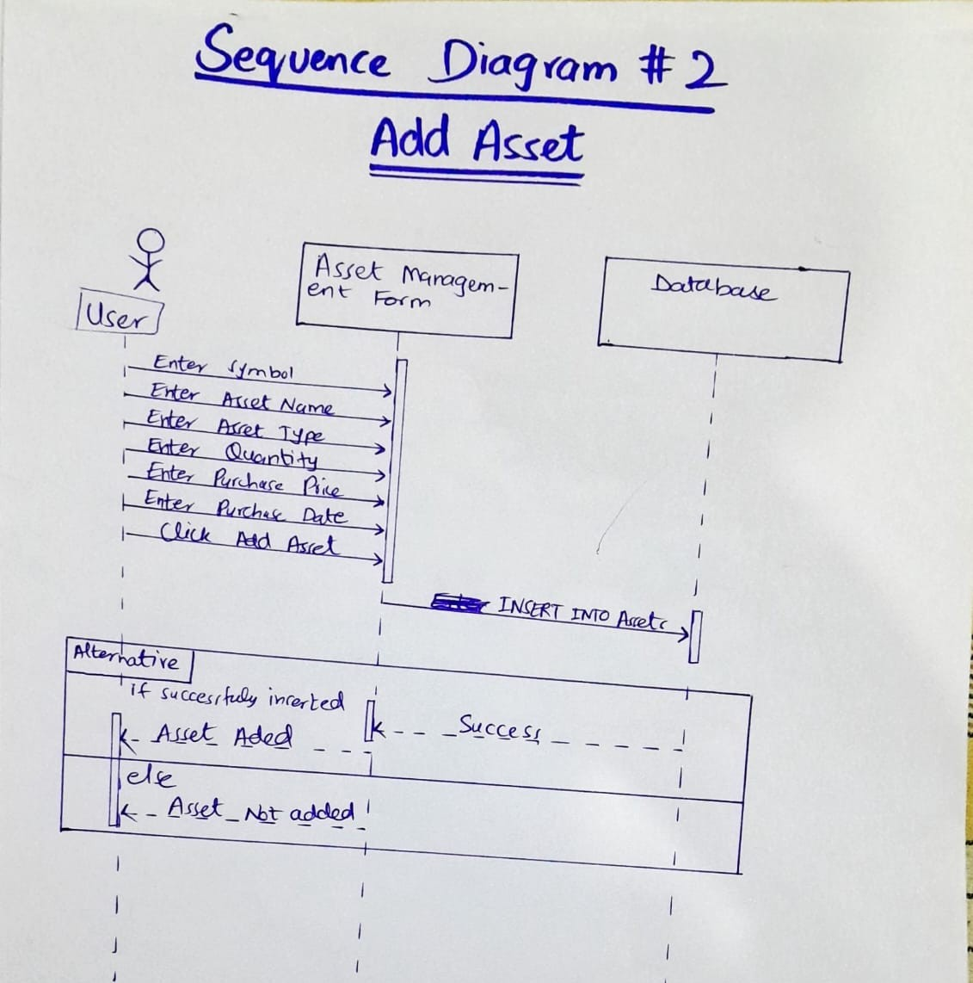
Sequence Diagrams

Slide 13
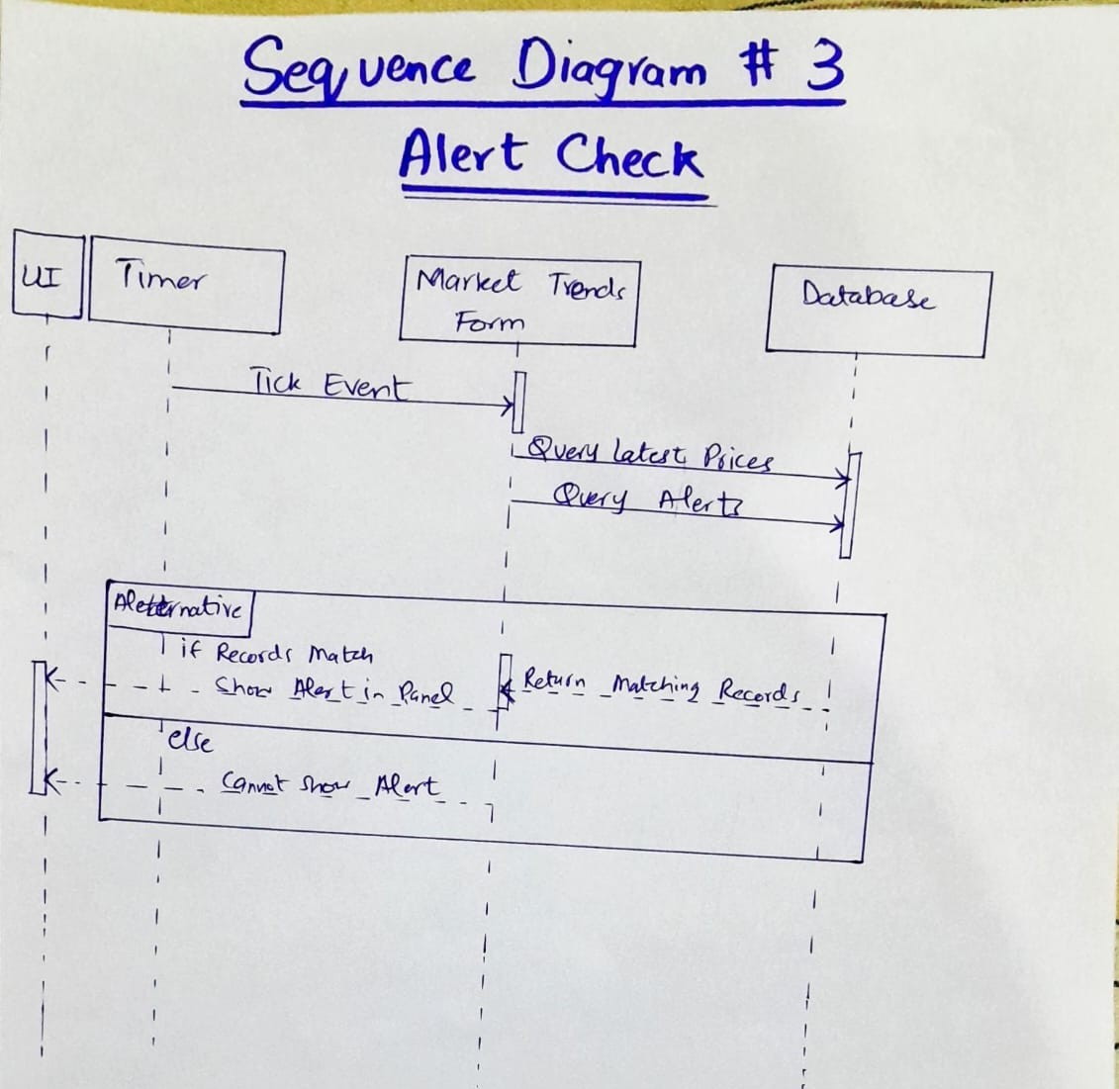
Sequence Diagrams

Slide 14
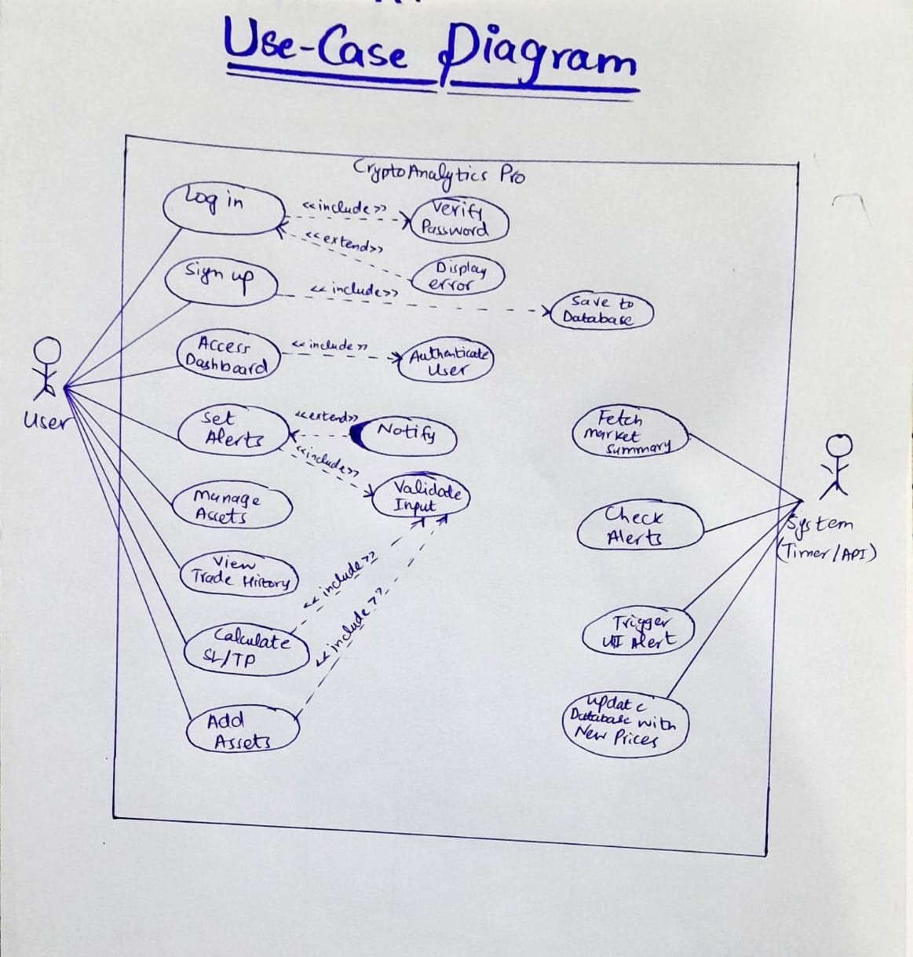
Use Case Diagram

Slide 15
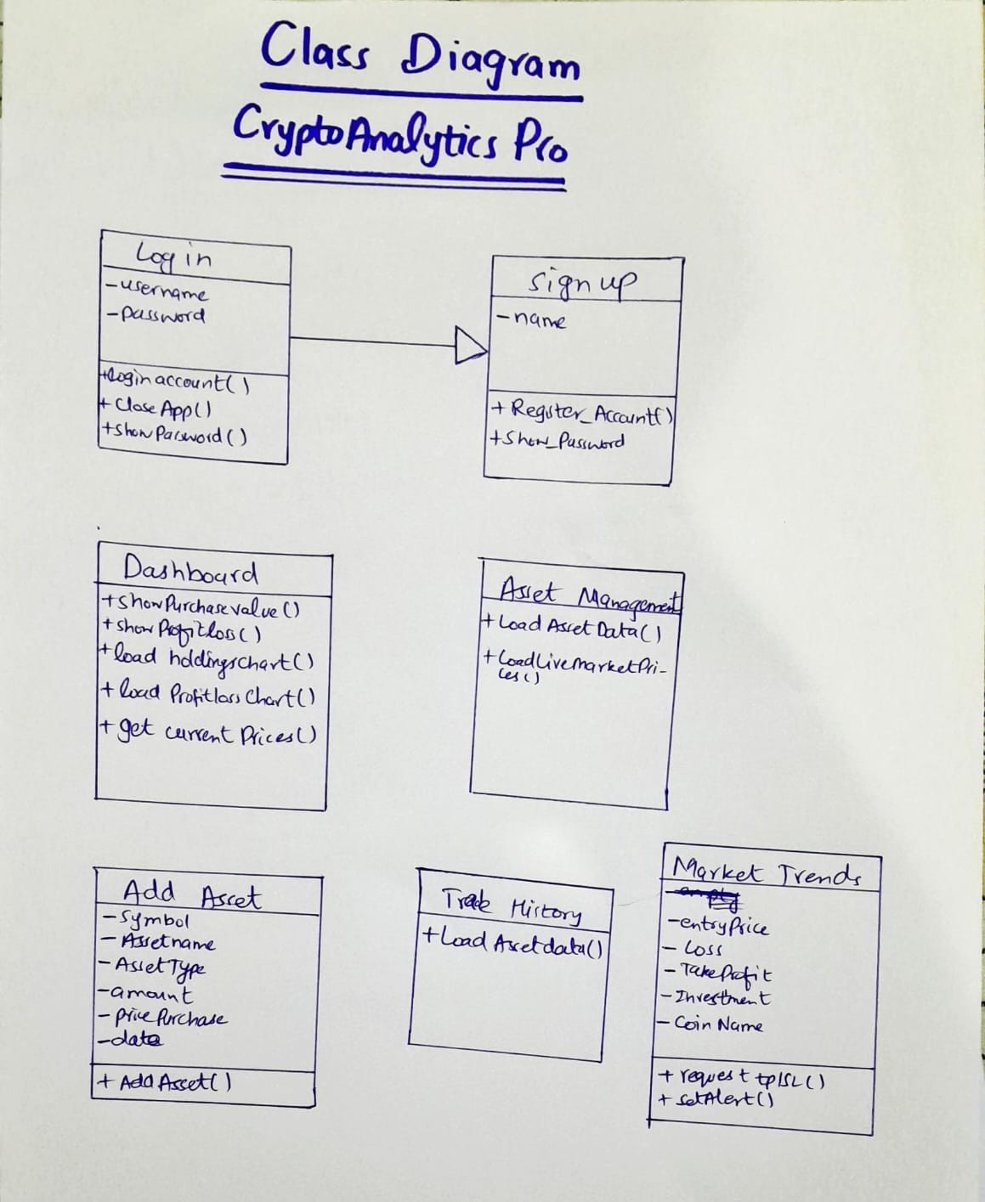
Class Diagram

Slide 16
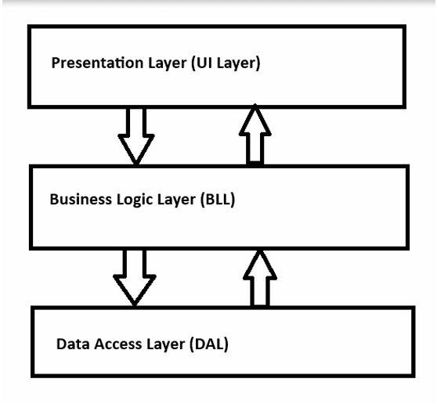
Architecture
Presentation Layer (UI Layer):
Handles user interactions and displays information. Contains:
● WinForms UI , Event handlers ,Displays sentiment, recommendations, and prices
Business Logic Layer (BLL) :
Handles all the core logic of the application. Contains:
● TradeAnalyzer.cs ,RecommendationEngine.cs , SentimentHelper.cs code files
3. Data Access Layer (DAL):
Handles all external data fetching from APIs. Contains:
● ApiService.cs , PriceFetcher.cs ,SentimentApi.cs code files

Slide 17
Implementation Screenshots

Slide 18
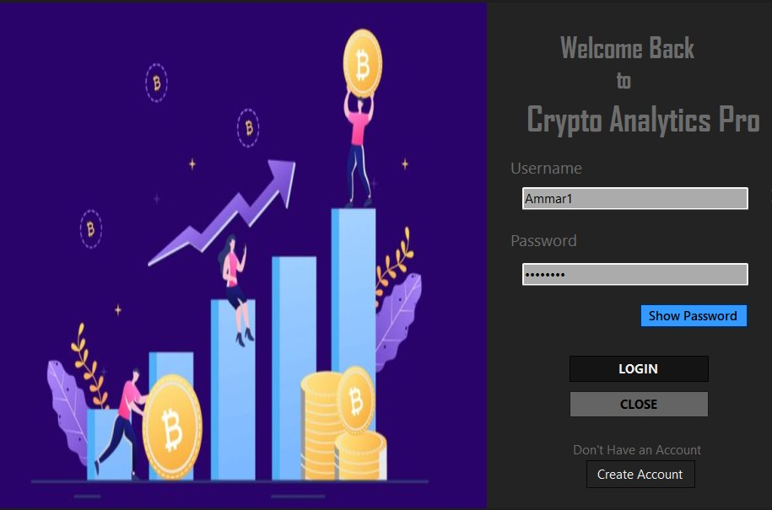
Log in / sign up

Slide 19
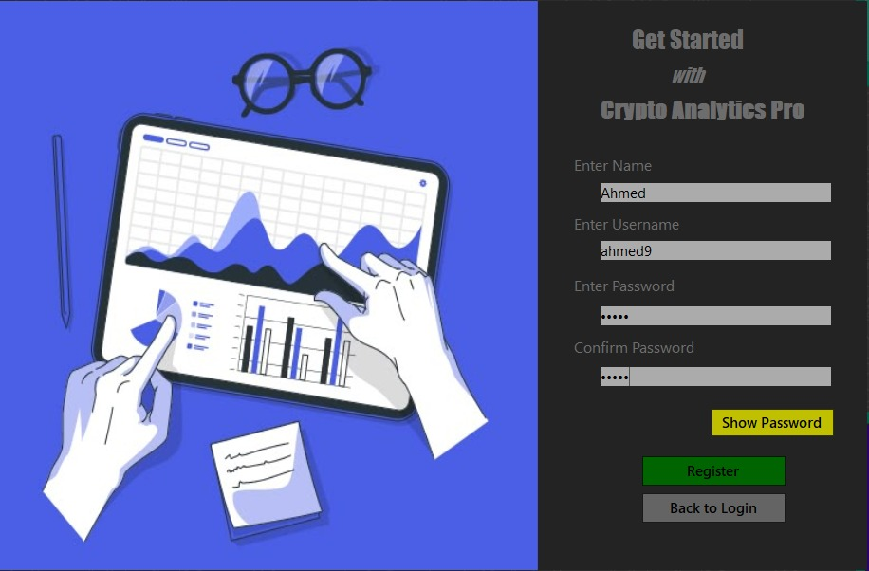
Log in / sign up

Slide 20
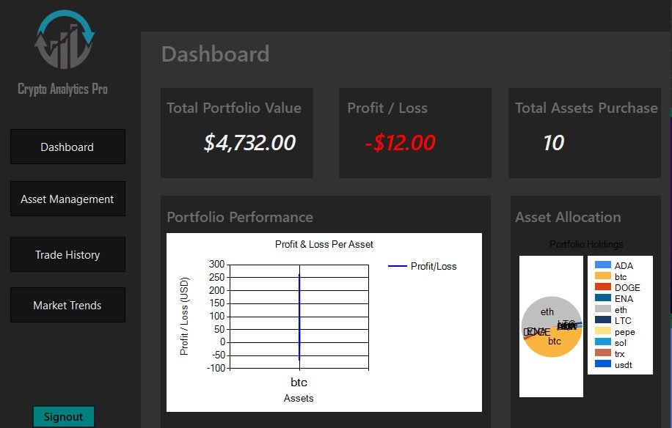
Dashboard

Slide 21
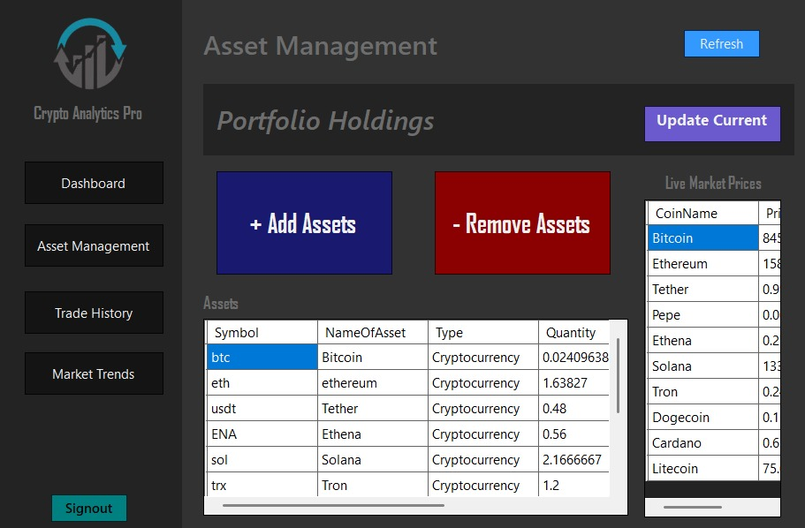
Asset management

Slide 22
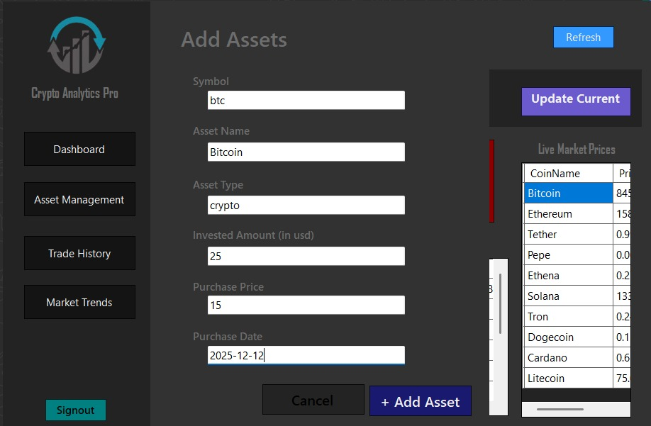
Add Asset

Slide 23
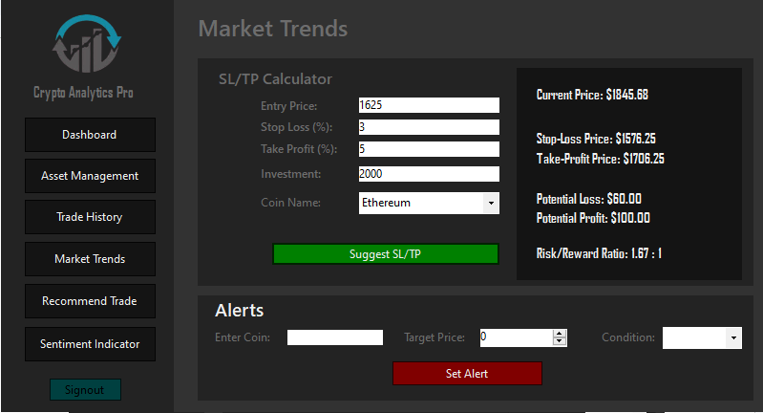
Market trends

Slide 24
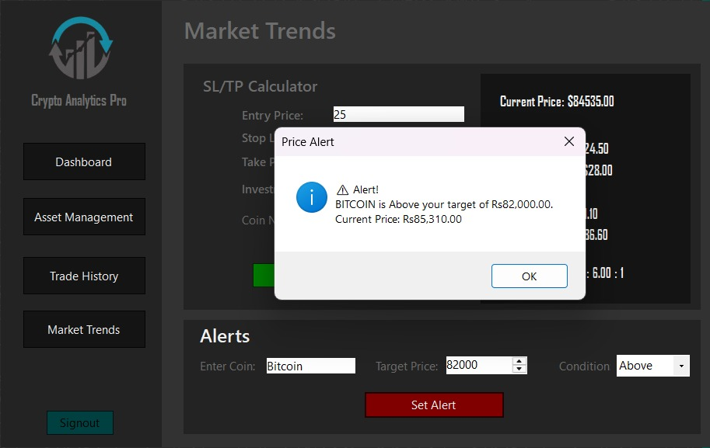
Market trends

Slide 25
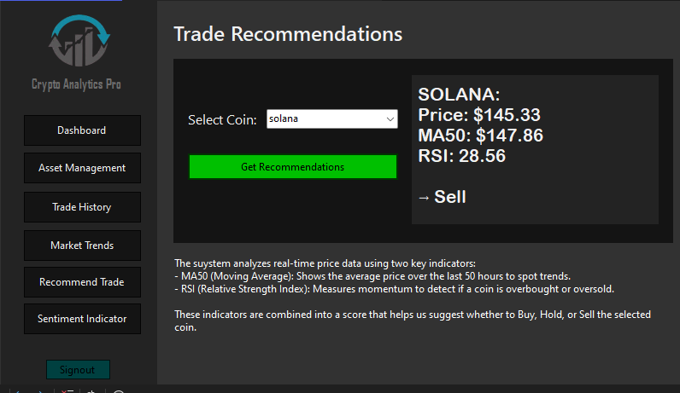
Trade recommendations

Slide 26
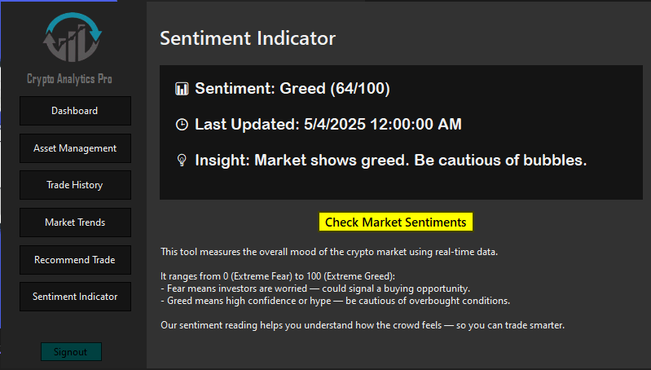
Sentiment analysis

Slide 27
Work Division

Slide 28
Muhammad Ali Saleem – API Integration & Sentiment Engine
Responsibilities:
Fetch historical price data (e.g., 50-hour price history) from CoinGecko API.
Connect to Alternative.me Crypto Fear & Greed Index for market sentiment.
Parse and return clean, usable data for analysis.
Add error handling for API timeouts, failures, or bad data.
Provide data-fetching functions to be used by the logic and UI teams.

Slide 29
Ammar Hassan – Dashboard & Recommendation System Lead
Responsibilities:
Design and implement the main dashboard UI (coin selector, buttons, display areas).
Handle the Get Recommendation feature flow from UI to backend.
Display AI-based trade recommendations with MA50, RSI, and signal summary.
Style the interface with clear labels, icons, and conditional coloring.
Connect button events to data and logic layers.

Slide 30
Hamza Mumtaz – AI Logic & Trade Signal Analysis
Responsibilities:
Implement core logic for MA50 and RSI calculation using fetched data.
Develop rule-based recommendation engine (Buy/Hold/Sell) using indicators.
Add explanation and optional confidence score to recommendation output.
Optimize and test indicator logic with mock or real data.
Assist with refining indicator thresholds and behavior.

Slide 31
Lesson learnt
Consistency in progress tracking is crucial; even small delays early on can compound and affect later phases.
Having a plan is important, but regularly checking our progress against it is what keeps the project on track.
We learned the importance of flexibility—adjusting our workload and approach when things didn’t go as expected.
Frequent team check-ins and stepping back to view the bigger picture help ensure long-term alignment.

Slide 32
Thank you

